Slide 1

Reliable Online Studio
Presented to
MD. NAZMUL HOSSAIN
Faculty
American International University-Bangladesh

Slide 2
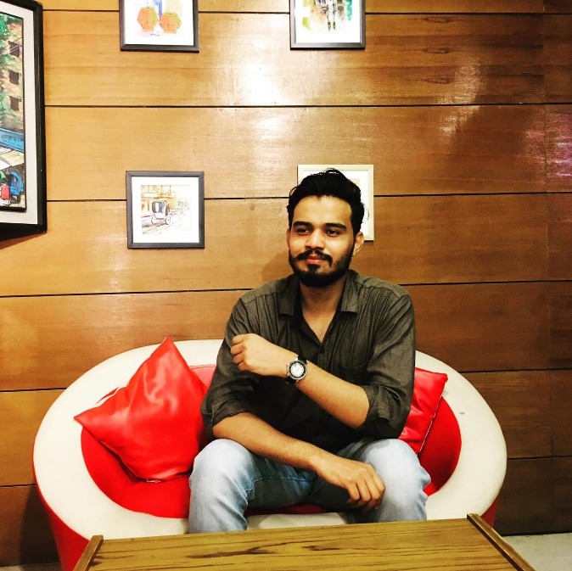
HELLO!
I am
Ifaj Hossan Omi
ID: 20-4287-1
Department: CSE

Slide 3

HELLO!
I am
Ayndreela Dey Monty
-
ID: 18-37798-2
Department: CSE

Slide 4
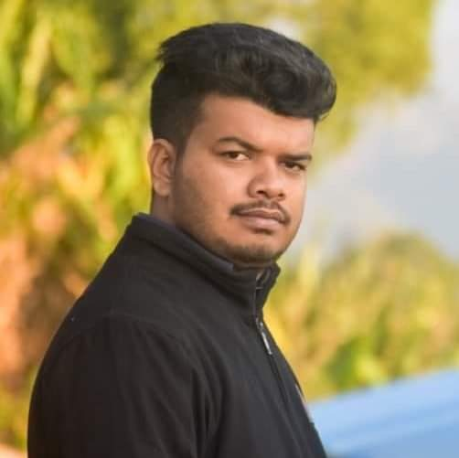
HELLO!
I am
SM Emran Hossain
-
ID: 18-36094-1
Department: CSE

Slide 5
Project Objective
My inspiration for this project related to photography always has been to help the community in a way so that everybody involved wins. For the first time, we are providing service as a studio that is secure and punctual. As we will have total control over the pieces of machinery used and the delivery process, customer's photos or videos cannot be misused. We will also be able to deliver the products in time. In case of any accident, there will be spare employees who will finish the work in time. To speak about other renowned freelancing platforms, novice but potential candidates cannot prosper because of their rating system. To solve the problem, we have introduced a new parameter that will let the customers know about the novice but potential candidates who may thrive shortly on top of the rating system of choosing the best photographer. In this way, even not-so-skilled novice photographers can challenge the professionals in terms of cost. We have tried our best to create such a platform where the customers and the photographers will be benefited greatly.

Slide 6
Project Details

Slide 7

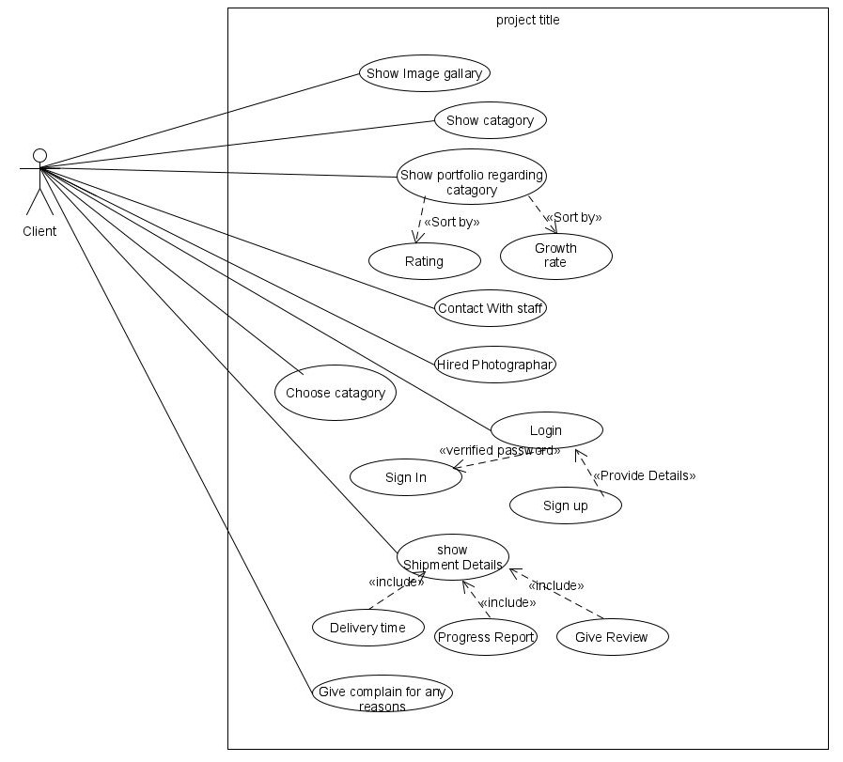
USER
Client

Slide 8
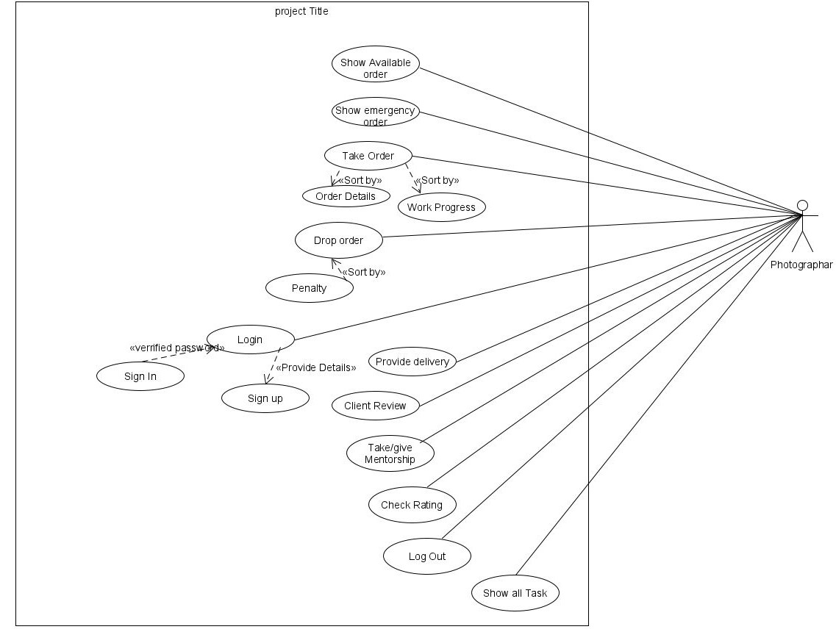

USER
Client
Photographer

Slide 9
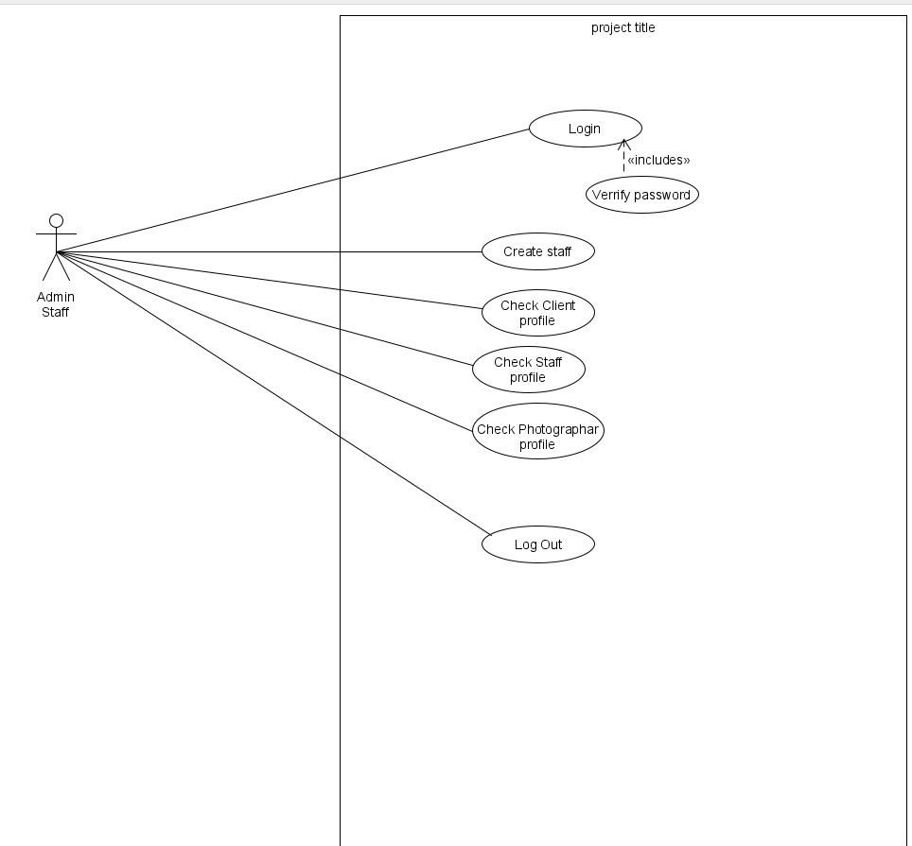

USER
Client
Photographer
Admin Stuff

Slide 10
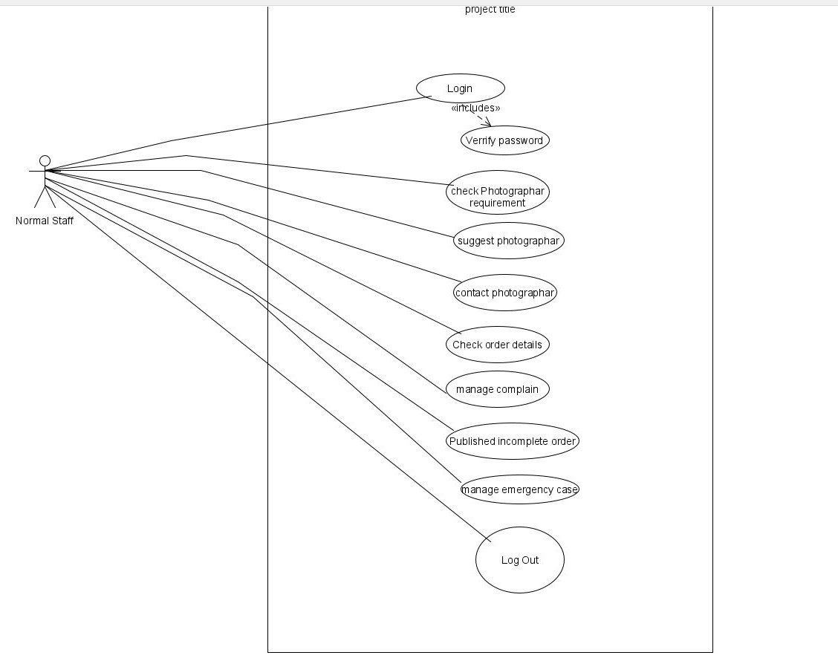




USER
Client
Photographer
Admin Stuff
Executable Staff

Slide 11
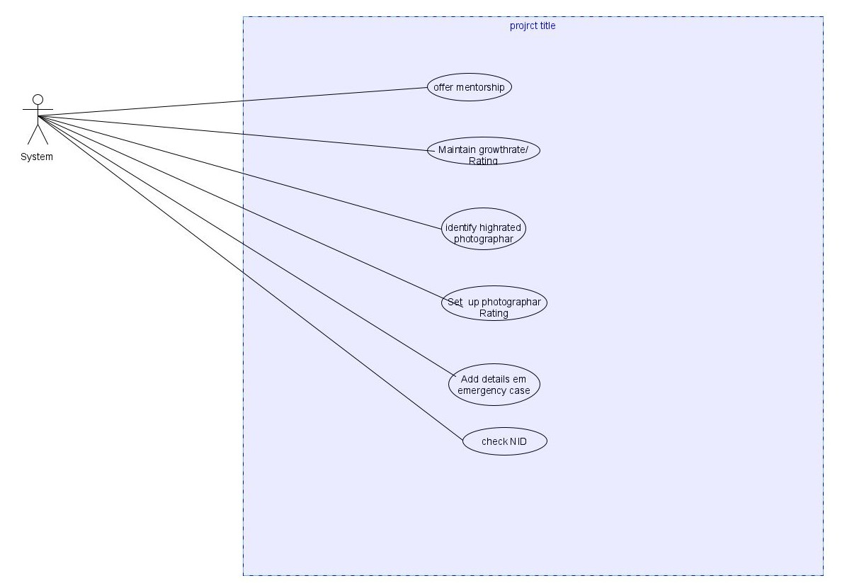

USER
Client
Photographer
Admin Stuff
Executable Staff
System

Slide 12
Functionality
Show Category :
There should be a string type array in system which name ‘category’. And using this function user will print.
Show Portfolio Regarding Category :
At first the user will be asked to input the category type. Then the user will be asked to input the sorting type. Then according to the category, the instances of photographers who are eligible will be extracted from the static array of photographers and will be saved to a new array. Then the new array will be sorted according to sorting type and the details will be printed one by one.
Contact Stuff :
This function will take input and show massage. From static array of staff system will select 1st instance. After that, system will send massage in staff’s instance with details information of client
Client

Slide 13
Functionality
Hire Photographer Or Team :
Client will choose that which photographer wants to hire as their requirement. User will input client requirement and then this order shift into array which should keep in photographer’s instance. And most important that if any client wants to hire photographer must login into system or this function will call ‘log-in’ function.
Login:
first ask user weather sign up or not. If yes User wants to login and password from client. Then, system will search username in all type of static array. If it match with any type of instance then password will check. If re-checking will done then system give access to login. And if this process will not done then attempt will decrees one time. A user must did attempt 5 times which must be in under tracking. If fail 5 times, then user kicked out from system. And when user sign up in system it will call sign up function.

Slide 14
Functionality
Sign Up :
First the user will be asked for user type. Then user will input the details. Then NID will be provided by the user and will be cross checked. If it matches, then instance will be created according to type and the details will be updated by the save instance implementation. The instance will be then stored on a static array and the counter will be increased by 1. If the details don't match then user will be told to try again. If user type is photographer then workflow also needs to be added with details. This will be sent to the staff in another static array. This will be achieved by checking each of the staffs one by one.
Show Shipment Status :
This function will bring out the photographer instance from stored static array by username and print the progress of the order. This function will also take input through add complaint function.

Slide 15
Functionality
Add Complain :
Client have full rights to protest about photographer or staff behavior , if client wants to. In This scenario, client can complain about them by using this system.
Log out :
Client can log out anytime from system.

Slide 16
Functionality
Log in :
First photographer will log in. In this scenario they faced two situation, once sign in and sign up. If photographer has not registration in system they must sign in with provide details and work folio task.
Show available order :
photographer can show which order is available for their .
Show emergency order :
Photographer can also show their emergency order if they have.
Take order :
Photographer can perceive order sort by order details and work progress.
Photographer

Slide 17
Functionality
Drop Order :
If any photographer have faced any serious problem in between work, he can drop this work. But in this case, photographer must give penalty.
Provide Delivery :
Photographer must have delivery in time.
Client Review :
After delivery work to the client photographer can confer client review.
Take/give mentorship :
The most important fact, photographer can take mentorship for grow their skill and give mentorship course with their growth rate and ratting if they interested.

Slide 18
Functionality
Show all task :
Photographer can show all of the task.
Check ratting :
They can check their ratting as well.
Log out:
Photographer can log out from the system.
review.

Slide 19
Functionality
Log in:
Admin staff can log in into system by using this function with verify password.
Create staff:
Admin can create staff for the system.
Check Client profile:
Admin staff can check client profile to know their details.
Check photographer profile:
Admin staff also can check photographer profile as well as.
Log out:
Admin staff can log out anytime from system.
Admin Staff

Slide 20
Functionality
Login :
normal staff can log in into system by using this function with verify password.
Check photographer requirement:
Normal staff will check photographer requirement as they can communicate with client easily.
Suggest Photographer:
They will suggest client that which photographer will best for their budget and requirement.
Contact Photographer:
They contact with Photographer with client requirement.
Check order details :
Before contact with photographer staff must check client order details.
Executable Staff

Slide 21
Functionality
Manage complain:
Staff will manage complain between client and photographer.
Publish incomplete order:
If any photographer did not complete their work, staff will publish this type of order.
Manage emergency case:
If any photographer did not eligible to complete their work, or if any client wants to take work urgently this type of situation is emergency case which maintain staff.
Log out:
Staff can log out anytime in system.

Slide 22
Functionality
Offer mentorship :
System will offer mentorship to the photographer.
Maintain Growth rate/ Ratting- System will automatically perpetuate the growth rate and ratting to the photographer.
Identified high rated photographer :
System will identified high rated photographer automatically from photographer profile.
Set up photographer ratting :
System will upraise the high ratted photographer thus when any client access the system they can show high quality work of high ratted photographer.
System

Slide 23
Functionality
Add details emergency case:
Any kind of emergency scenario will control system, and inform to staff and photographer.
Check NID:
When a user enter into system, they should register their account with NID. Which check automatically.

Slide 24
Contribution
Md. Ifaj Hossan Omi
I will provide the functionalities of the project and draw the user interface.
Ayndreela Dey Monty
I will do class, properties, attributes, data structure of our class.

Slide 25
Limitation
We could not implement features for admin staff.
Mentorship option has not been created
We could not properly use the growth rate here.
Photographers were not given special features with respect to their growth rate.
A full row cannot be selected at once in the data grid
The security and password management is not strong. There is no limit to the login attempt
User input handling is not strict. Which opens for possibilities of more bugs.

Slide 26
Functionalities
Adding in option for admin stuff
Creating a more professional and user friendly UI and add more functionalities
Optimize the app more by removing unnecessary code
Tracking improvement of photographers using growth rate
Think about this app also from a business point of view and taking it to top markets
Helping great but new photographers. New photographers can face difficulty at first building their portfolio. If they can do great work then showing them to various clients for a brief time. This will create uniform and equal opportunity for everyone in the market.

Slide 27
THANK YOU

